Slide 1
Classification of
Shoulder Implants
CISC372 Final Project Report
Meng(Simon) Zhou, Shanglin Mo

Slide 2
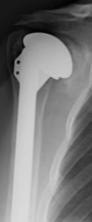
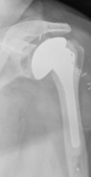
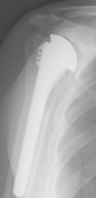
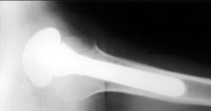
Problem & Dataset
Classify Unknown Shoulder Implant X-Ray Manufacturer
Zimmer
Tornier
Depuy
Cofield
Data Source:
University of California Irvine Machine Learning Repository
The dataset contains 597 X-Ray images from 4 manufacturers
Cofield: 83, Depuy: 294, Tornier: 71, Zimmer: 149 (imbalanced dataset)
Notes:
The problem is to classify right shoulder implant manufacturer based on the implants’ X-ray images.
We will apply different models and compare the performance of classification of traditional non-Neural Network models with some famous Neural Network models.
The dataset is from University of California Irvine Machine Learning Repository. The set contains 597 X-Ray images from 4 manufacturers, but the number of images of each manufacturers are imbalanced. This will possibly affect the results of classification

Slide 3
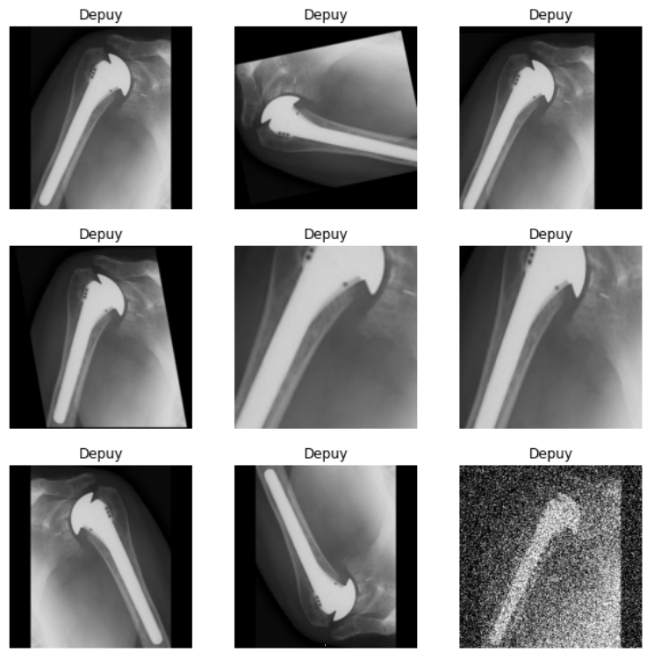
Data Augmentation
Augmentation Methods
Rotate
Translate
Shear
Scaling
Cropping
Flip left to right
Flip upside down
Add noise
After augmentation: 4023 X-ray images
Notes:
Due to the limited number of dataset. We use the data augmentation technique to generate another 8 images from an existing image. After the augmentation, we have 4173 images in total.
For the test dataset, in order to simulate the real-life X-ray images, we randomly 25%(150) from the original image set. And use the rest of the original dataset along with the augmented images as the training set(4023).
During the training process, because of the RAM limitation of google colab, we have to reduce the size of data augmentation by only selecting random rotation, scaling, cropping and horizontal flip as the final augmentation techniques. the new augmentation images reduce to 2235 images for training and 150 images for testing.
We normalized all images and shape them to 256x256x3, each pixel will have value from 0 to 1.

Slide 4
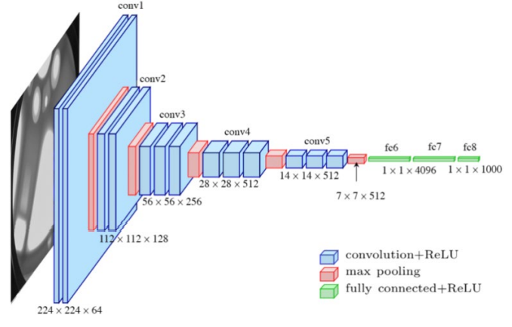
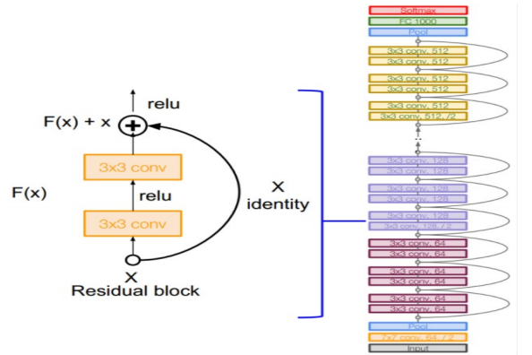
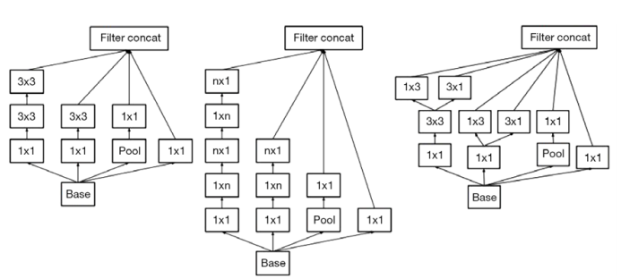
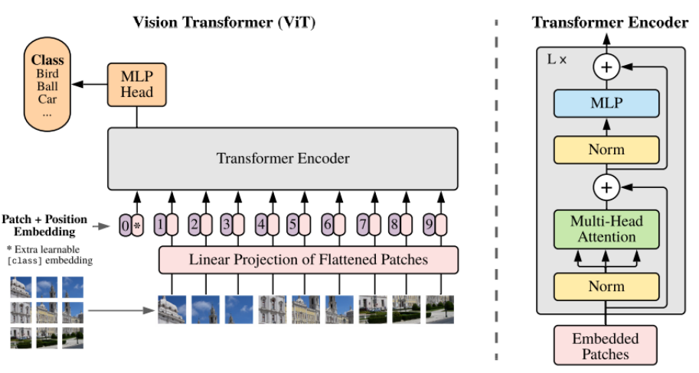
Deep Learning Models
VGG-16
ResNet-50
InceptionV3
Vision Transformer
Notes:
VGG-16:
It is a very popular CNN architecture that is always used for image classification task, it also achieves a high accuracy score very often.
The architecture composed of many 3x3 convolutional filters with a stride of 1 and max pooling layers of 2x2 window with stride of 2. After the convolutional operation is done, the network adds several fully connected layers with 2048 units and finally with a 1000 dimension of output for 1000 classes in ImageNet classification task
ResNet-50:
ResNet-50, also known as 50-layer Residual Network, is another popular Convolutional Neural Network that proven to be powerful for classification problems.
The Residual Net model contains the skip connection feature, which will be adding some of the inputs of stacked convolutional layers to the output directly. This will reduce the chance of gradient vanishing.
InceptionV3:
InceptionV3 is also a powerful network for image classification and recognition, and it is invented by Google Research in 2015.
The Inception model replaces the determination of convolution filter size with several common filter sizes (1x1, 3x3, 5x5), then concatenate the result from those filter size as the input of pooling and fully connected layer.
Vision Transformer:
Transformer is a popular and powerful model in the field of Nature Language Processing. The basic idea behind transformer is self-attention, where each word is connected to every other word in an NLP model.
The idea behind Vision Transformer is using the encoding part to perform classification. The input image is separated by many small patches and then flattened into a linear shape. Each patches of image have been converted to a numpy array as the input of Transformer encoder, and a learnable class token are also pass into the encoder for classification propose.

Slide 5
Classification Results
Model | Augmented | VA | TA | TP
Random Forest | No | 0.52 | N/A | 0.50
Random Forest | Yes | N/A | 0.48 | 0.40
KNN | No | 0.53 | N/A | 0.50
KNN | Yes | N/A | 0.41 | 0.40
VGG-16-scratch | No | 0.45 | N/A | 0.38
VGG-16-TL | No | 0.49 | 0.49 | 0.49
ResNet-50-TL | No | 0.49 | 0.49 | 0.49
ResNet-50-TL-cv | Yes | 0.88 | 0.77 | 0.81
InceptionV3 | No | 0.66 | N/A | 0.61
InceptionV3-TL-cv | Yes | 0.77 | 0.55 | 0.51
Vision Transformer | Yes | 0.50 | 0.43 | 0.34
Vision Transformer-TL | Yes | 0.88 | 0.68 | 0.71
VA: validation accuracy, TA: test accuracy, TP: Test Precision, TL: applied Transfer Learning, CV: applied cross-validation
Notes:
From the results table we can tell deep learning method is proven to be successful in the classification of shoulder implant manufacturers. The ResNet-50 with transfer learning and cross-validation that trained on the augmented data demonstrates the best precision score overall. Convolutional Neural Network works excellent on the dataset with images.
Another significant finding is the power of data augmentation. Data augmentation provides additional data for training, it could enlarge the variation of the existing data, lower the chance of overfitting and boosting the accuracy of models.

Slide 6
Conclusion
DL methods perform better than traditional ML models
DL methods perform well in the shoulder implants manufacturer classification
Data augmentation, transfer learning and cross-validation are effective to improve the model performance.

